Slide 1


ETL & data analysis with python
presented by Salma Essam

Slide 2
about us
Alaa Atef Mustafa
Gehad Emad Mohamed
Haneen Alaa
Salma Essam Mohamed
Mirna Sherif Zayed

Slide 3
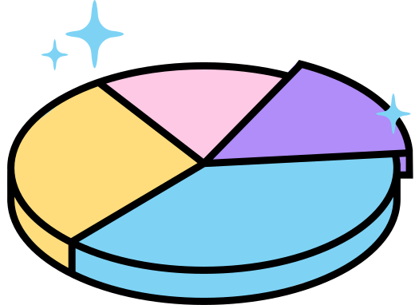
dwh with postgresql
our team has successfully transitioned all SSIS packages to use PostgreSQL as the destination by leveraging ODBC destination components. This change likely involved modifying each SSIS package to replace the existing destination components (which were likely pointing to SQL Server or other databases) with ODBC components that connect to the PostgreSQL database.

Slide 4
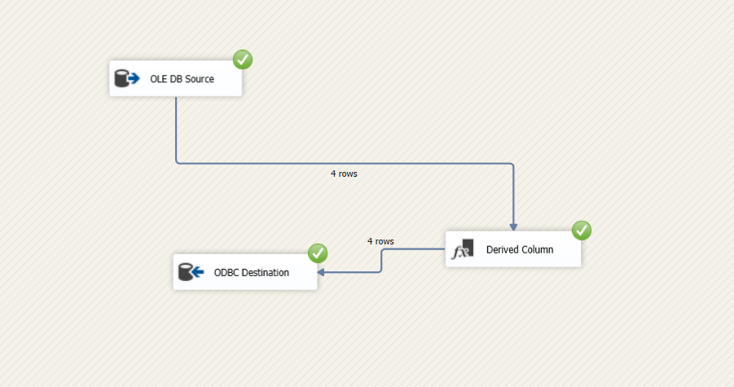
fact table

Slide 5
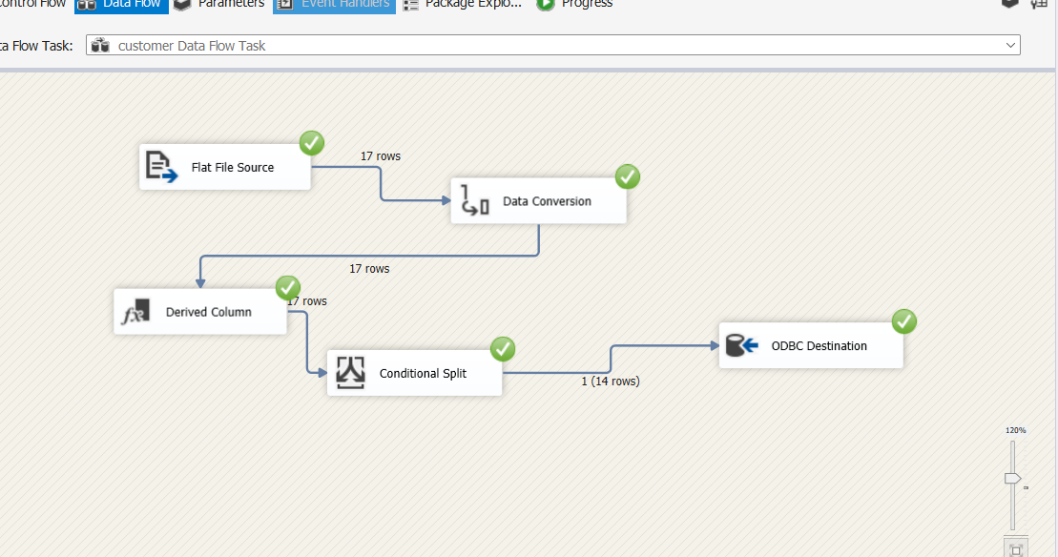
Customer dimension

Slide 6
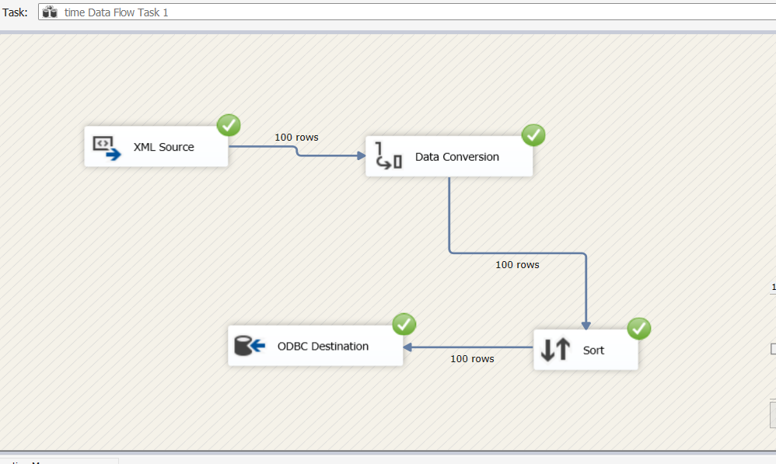
Time dimension

Slide 7
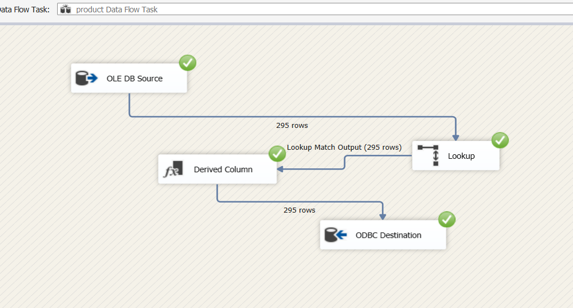
Product dimension

Slide 8
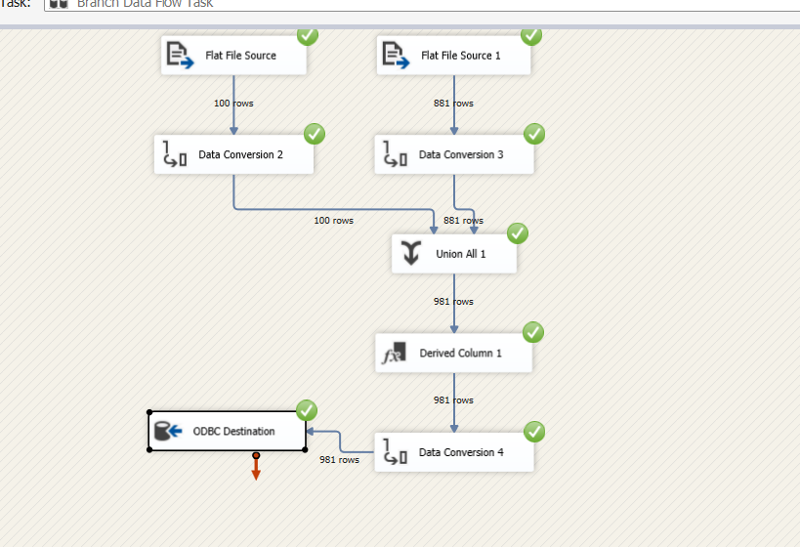
branch dimension

Slide 9
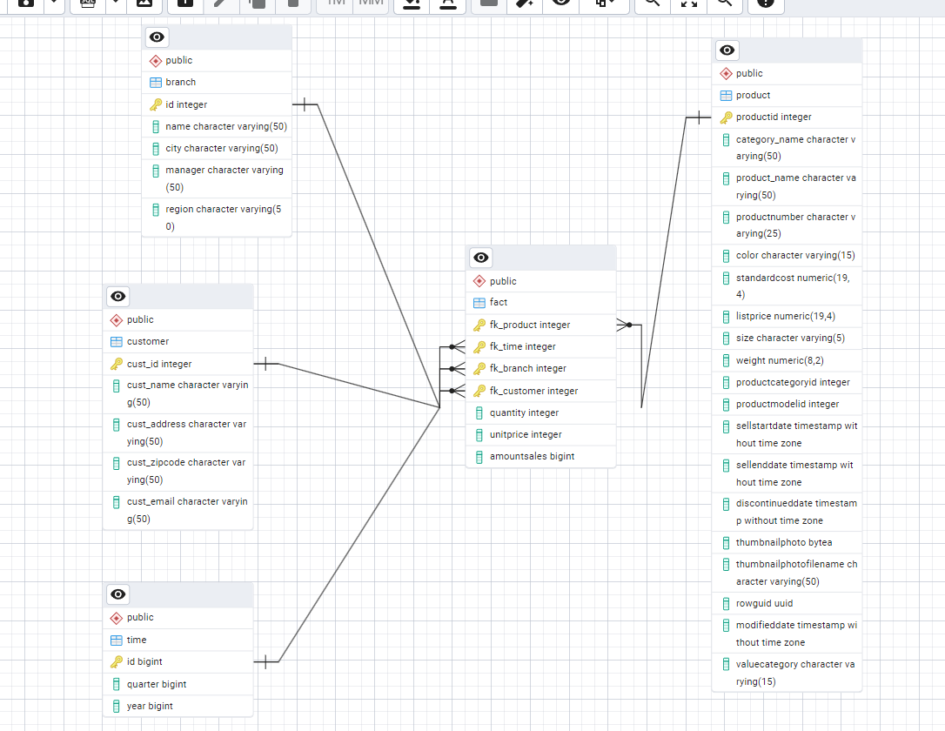
ERD
Diagram

Slide 10

data before analysis
The problem we're addressing is the presence of null values in the product data, specifically in the category_name column. These missing values make it difficult to get an accurate count of products in each category, leading to gaps in understanding product distribution. To solve this, we need to clean the data by either removing or filling these null values to ensure a complete analysis.

Slide 11
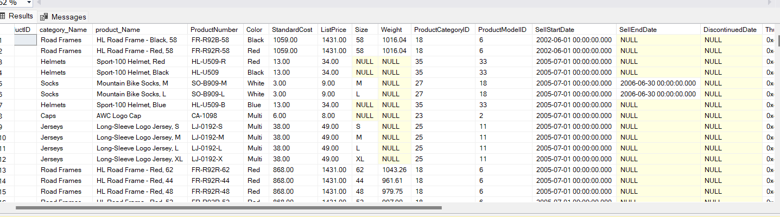

Slide 12
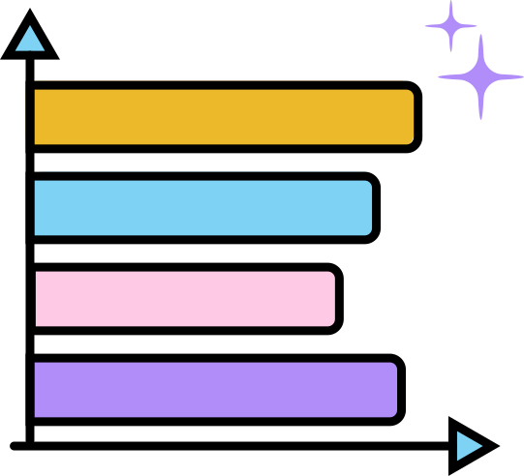
analysis with python
To proceed with the analysis after identifying and handling the null values, we follow these steps:
Data Cleaning: First, we decide how to handle the null values in the category_name column. We can either:
Remove rows with null values .
Fill the null values with appropriate substitutes.

Slide 13
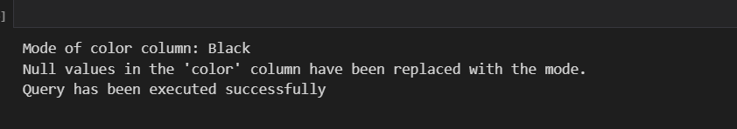
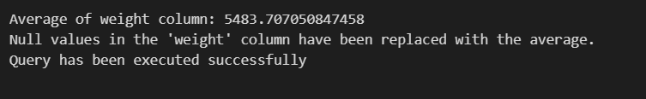
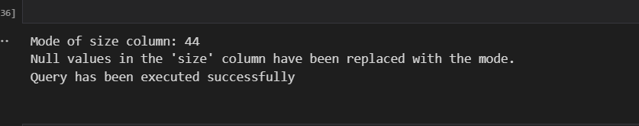

Slide 14

analysis with python
Grouping and Counting: After cleaning the data, we group the products by their category_name and count the number of products in each category.
Visualization: We create a bar plot to visually display the number of products in each category.
Interpretation: Finally, we interpret the results by looking at which categories have the most and least products.

Slide 15
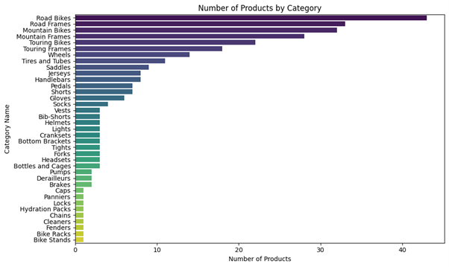
# Product by category

Slide 16
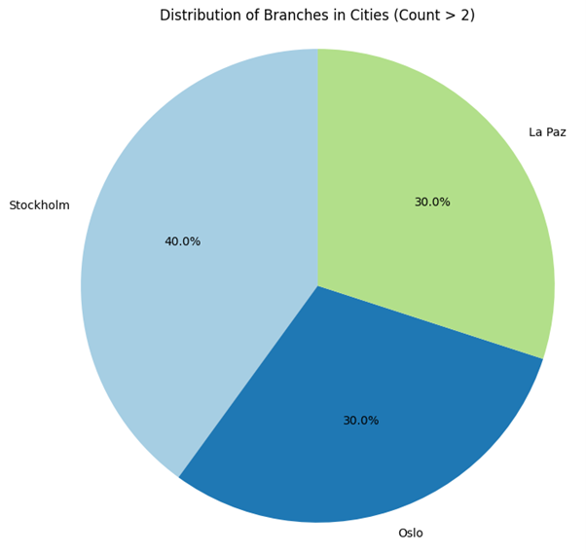
Distribution of
Branches
in Cities (Count > 2)

Slide 17
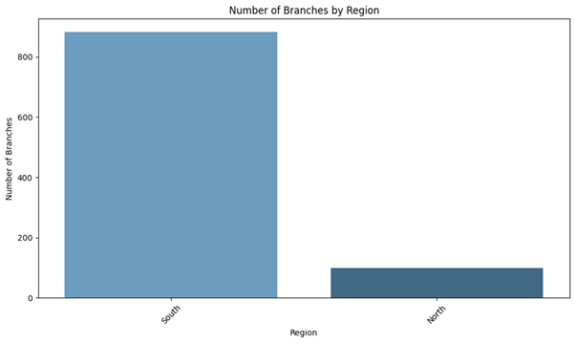
# branches
by region

Slide 18

Thank you for
your attention !

